Slide 1
Deep Dive 7
Jersey Citi Bike
Predicting Bike Demand through Rideshare Network

Slide 2
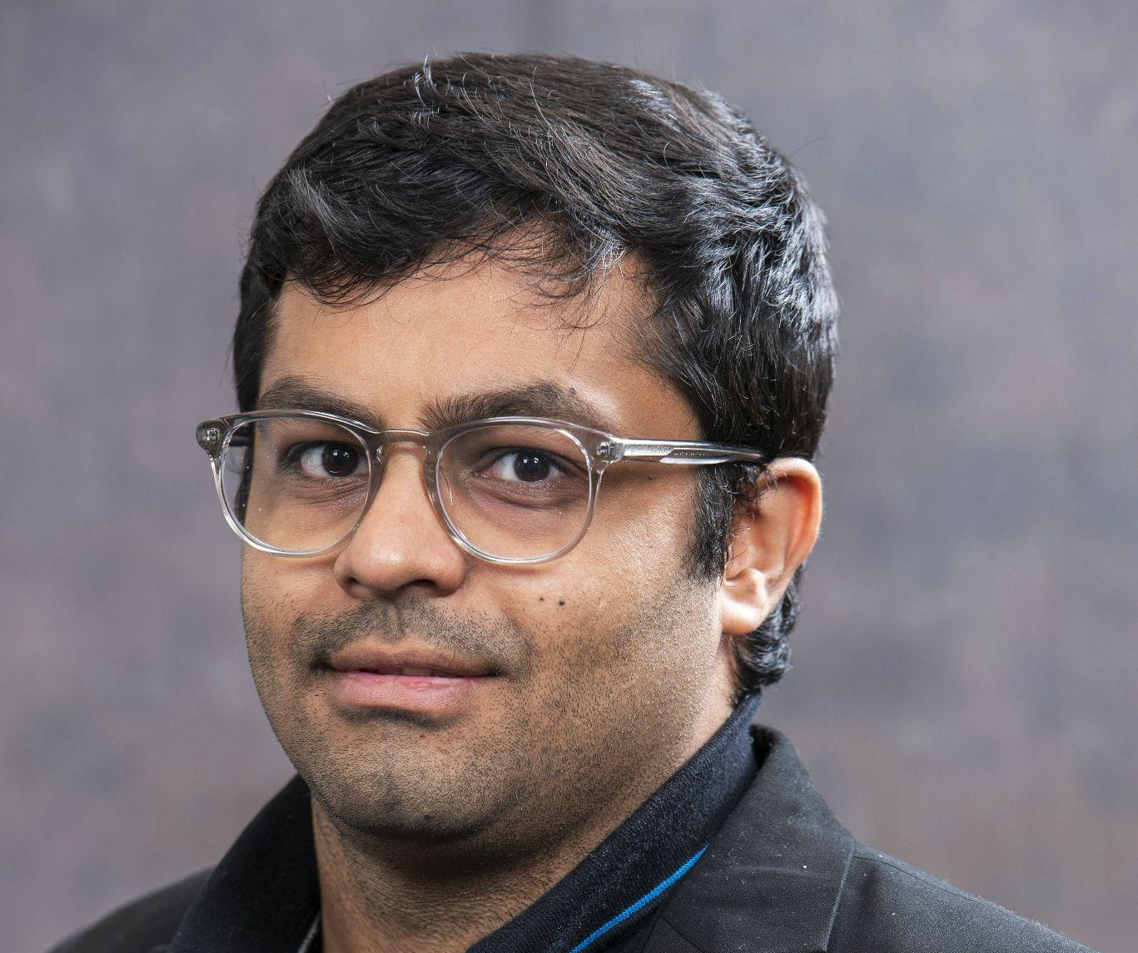



Our Team
Nikhil Arora
na32@illinois.edu
www.linkedin.com/in/nikhil-arora-uiuc
Gaurav Bhandari
gauravb4@illinois.edu
www.linkedin.com/in/gaurav-bhandari-52417411b
Srushti Manjunath
srushti5@illinois.edu
https://www.linkedin.com/in/srushti-manjunath/
Sarath Saroj
ssaroj2@illinois.edu
https://www.linkedin.com/in/sarathsaroj/
Nikhil Arora, Gaurav Bhandari, Srushti Manjunath, Sarath Saroj
Nikhil Arora, Gaurav Bhandari, Srushti Manjunath, Sarath Saroj
Notes:
Introduce background information and present standing

Slide 3
Agenda
Problem Statement
Initial Setup
Data Exploratory Analysis
Model Implementation
Results/Conclusion
Technical Challenges
Learning Experience
Future Considerations
Nikhil Arora, Gaurav Bhandari, Srushti Manjunath, Sarath Saroj

Slide 4
Timeline
1
2
3
4
Milestone 1
Milestone 2
Milestone 3
Milestone 4
Setting up the Project
Data Exploration
Baseline Learning Model
Spatial Temporal Model
Nikhil Arora, Gaurav Bhandari, Srushti Manjunath, Sarath Saroj
Notes:
Explain the set of the course early on and how we worked around it

Slide 5
Problem Statement

Slide 6
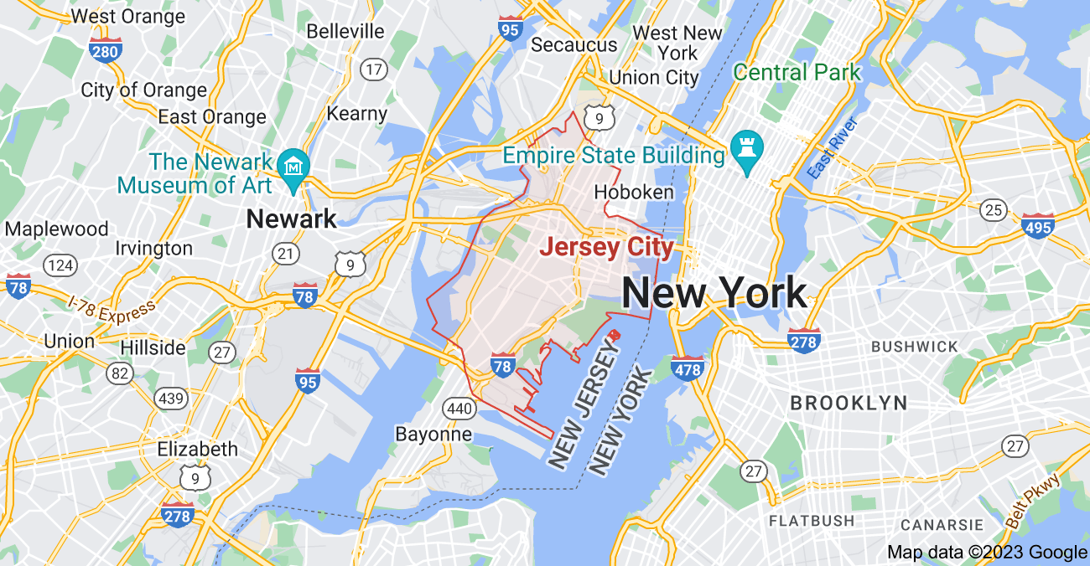
Problem
The problem was to use the CitiBike Data to predict number of rides for all stations in the network.
With this prediction model we can optimize the placement of bikes throughout the network
The model uses Jersey Citibike data to predicted using historical data the net rides from each station.
We utilized the SpatioTemporal Graph Convolutional Network(STGCN) model
Nikhil Arora, Gaurav Bhandari, Srushti Manjunath, Sarath Saroj
Notes:
Elaborate on the need to change the problem statement and why we chose to limit it to Jersy City for the recording. Explain net rides

Slide 7
Exploratory Data Analysis

Slide 8
Data
Data used for analysis is from https://ride.citibikenyc.com/system-data
Rides data from 01-01-2017 to 10-01-2023 in Jersey City
This data range was chosen as it would help us study patterns in the data over a number of years and hence we can make predictions with greater confidence.
Nikhil Arora, Gaurav Bhandari
Notes:
Explain the date range and why this was chosen

Slide 9
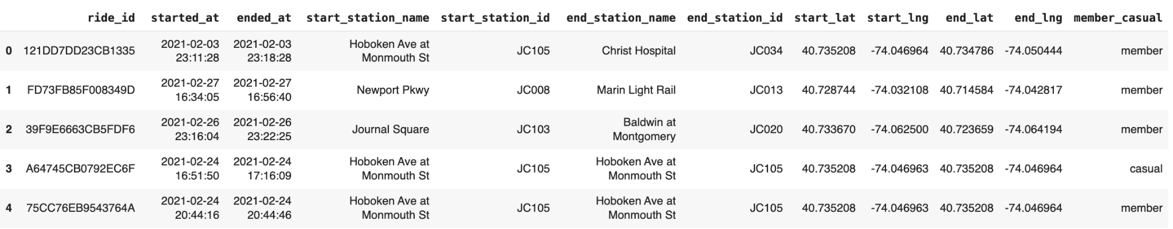
Merged Dataframe
Missing start_station_ids: 77 removed
Missing end_station_ids: 9168 removed
Final Dataframe shape: (3678270,11)
We did our exploratory data analysis on around 3 million rides in the Jersey City area
Srushti Manjunath, Sarath Saroj

Slide 10
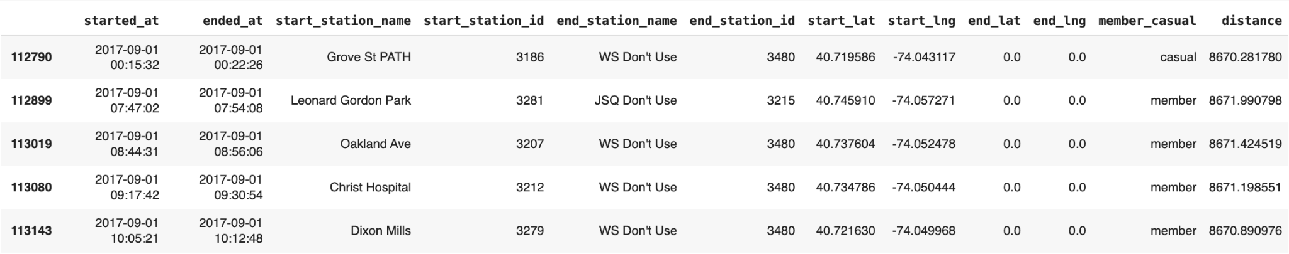
Distance Outliers Removed
We use haversine distance to calculate the distance between the start station and end station of each ride specified by their latitude and longitude coordinates.
We drop ride outliers that are 3 standard deviations away from the mean distance of all rides (787 rides).
After finding the durations of the rides, we also drop another 97 rows which have negative durations.
Srushti Manjunath, Sarath Saroj

Slide 11
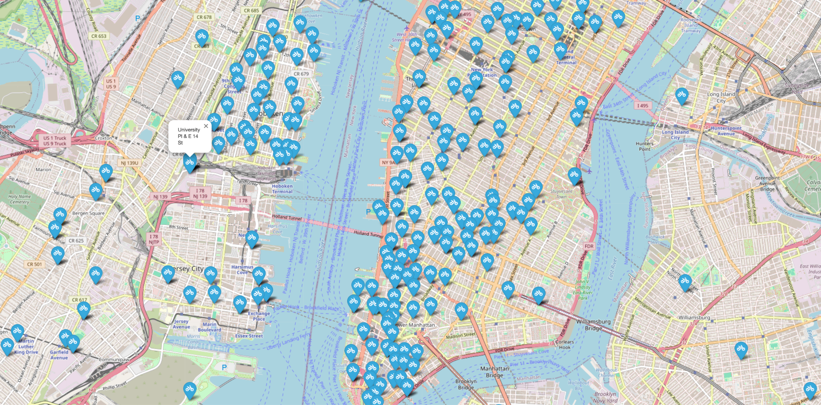
Network Visualization
We created an interactive map by overlaying the latitudes and longitudes of each station.
Hover over the station to check station names
Srushti Manjunath, Sarath Saroj

Slide 12
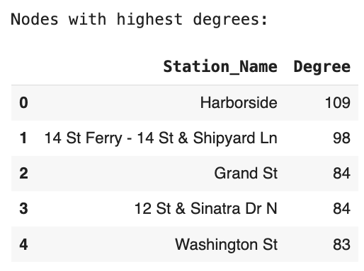
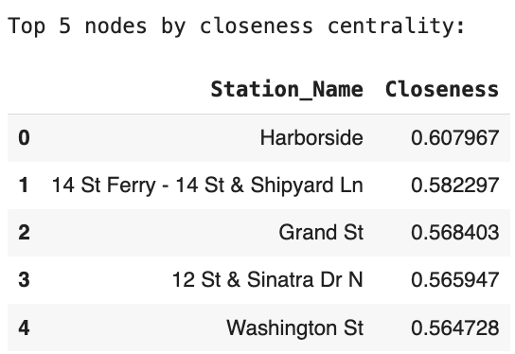
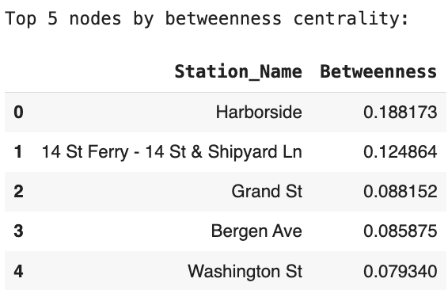
Centrality Analysis
Degree centrality of a station shows the number of neighbors a station has.
The above stations with high degree centrality can be considered as hubs or highly connected stations in the network.
Closeness centrality of a station shows how close a station is to all the other stations in the network.
The above stations with high closeness centrality act as a central hub that allows for quick travel to other locations.
Betweenness centrality shows the extent to which a station acts as a bridge between other stations in the network.
The above nodes with high betweenness centrality can easily connect the stations that are not directly connected.
Nikhil Arora, Gaurav Bhandari
Notes:
These stations are important junctions, where we should have good availability of bikes as they are central points from where people can walk to incase there is no bike availability at their nearest local station.

Slide 13
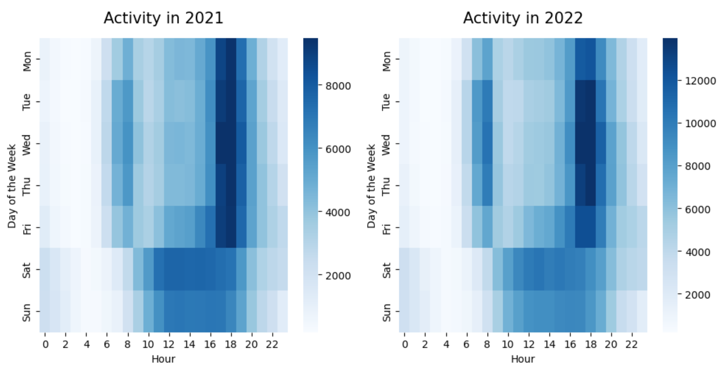
Heatmap: Activity by the Hour: Weekday vs Weekend
We see that the total number of rides on weekdays is much higher prior and after office hours.
On weekends, activity increases midday with a higher concentration of rides between 12 and 4 pm.
Srushti Manjunath, Sarath Saroj

Slide 14
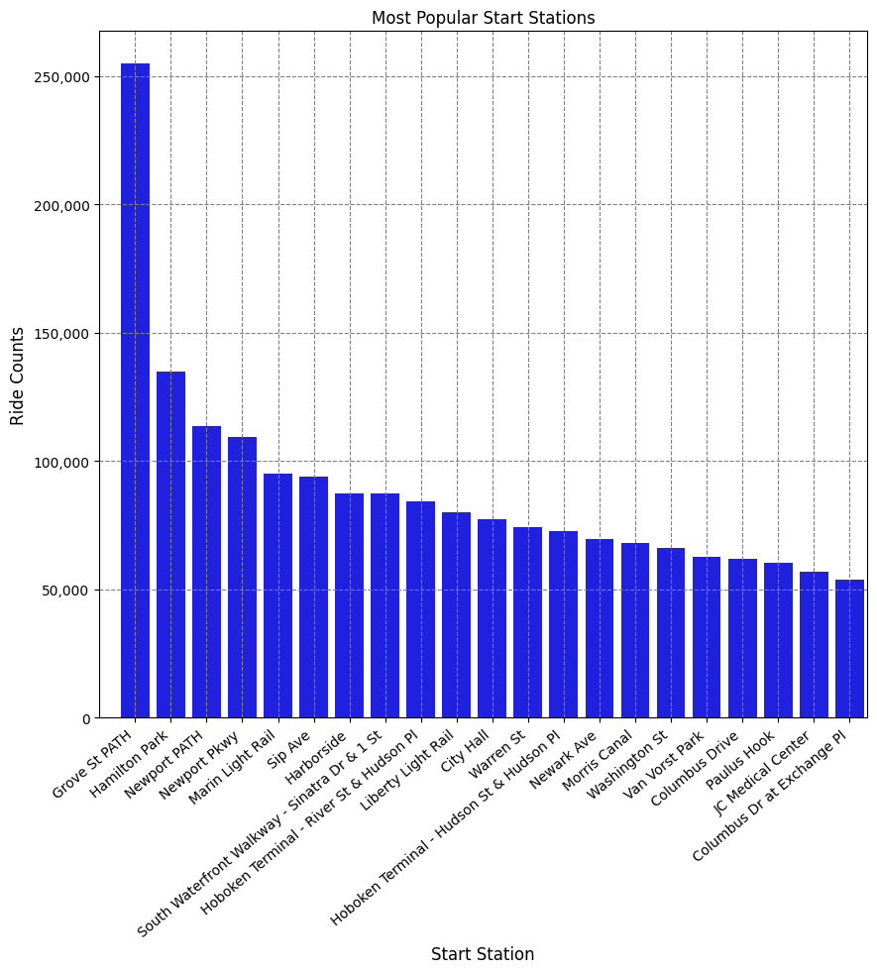
Top 20 Start Stations
The number of rides that are originating from the top 20 most popular start stations give us a better idea of which stations to place more bikes at the start of each day, as this will follow the same trend if we look at it on a daily basis.
Nikhil Arora, Gaurav Bhandari

Slide 15
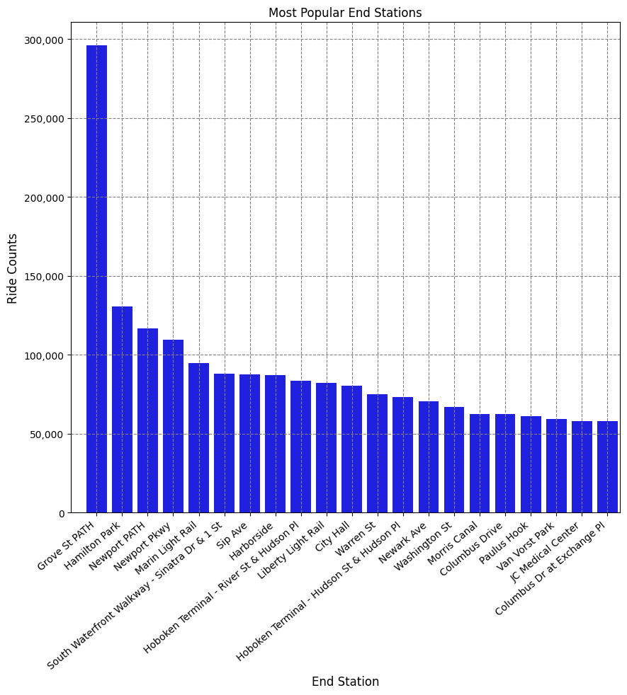
Top 20 End Stations
If an end station is very popular, but we find that the same station does not have many rides originating from there, then we can direct rebalancing vans to move bikes from that end station to more popular start stations so supply meets demand at the popular start stations.
However we see that both the top 20 start and end stations are very similar in ride counts, so these can be considered as hubs in the network.
Nikhil Arora, Gaurav Bhandari

Slide 16
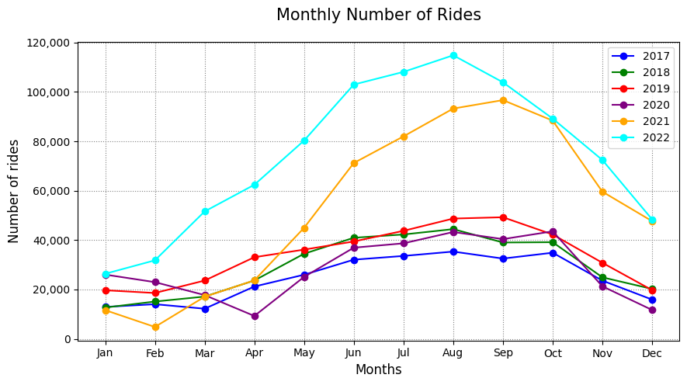
Seasonality
We see a seasonality trend in the data with a much higher number of rides in the summer months when compared to the winter months.
We decided to include this as a feature in our baseline model to help our predictions.
Nikhil Arora, Gaurav Bhandari

Slide 17
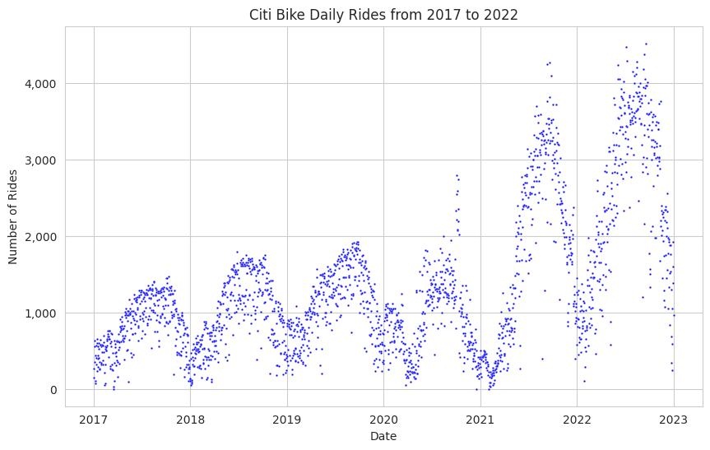
Yearly Trends
Cumulative Rides over Years
There is also a trend in the overall year on year on growth.
There is clearly a rising demand over the years(evident in the last two years- post COVID-19) so we can infer that this is a growing industry.
It has a cyclical demand pattern. There is seasonality in the data, with peaks in the summer months and valleys in the winter months.
Nikhil Arora, Gaurav Bhandari

Slide 18
Baseline Model

Slide 19
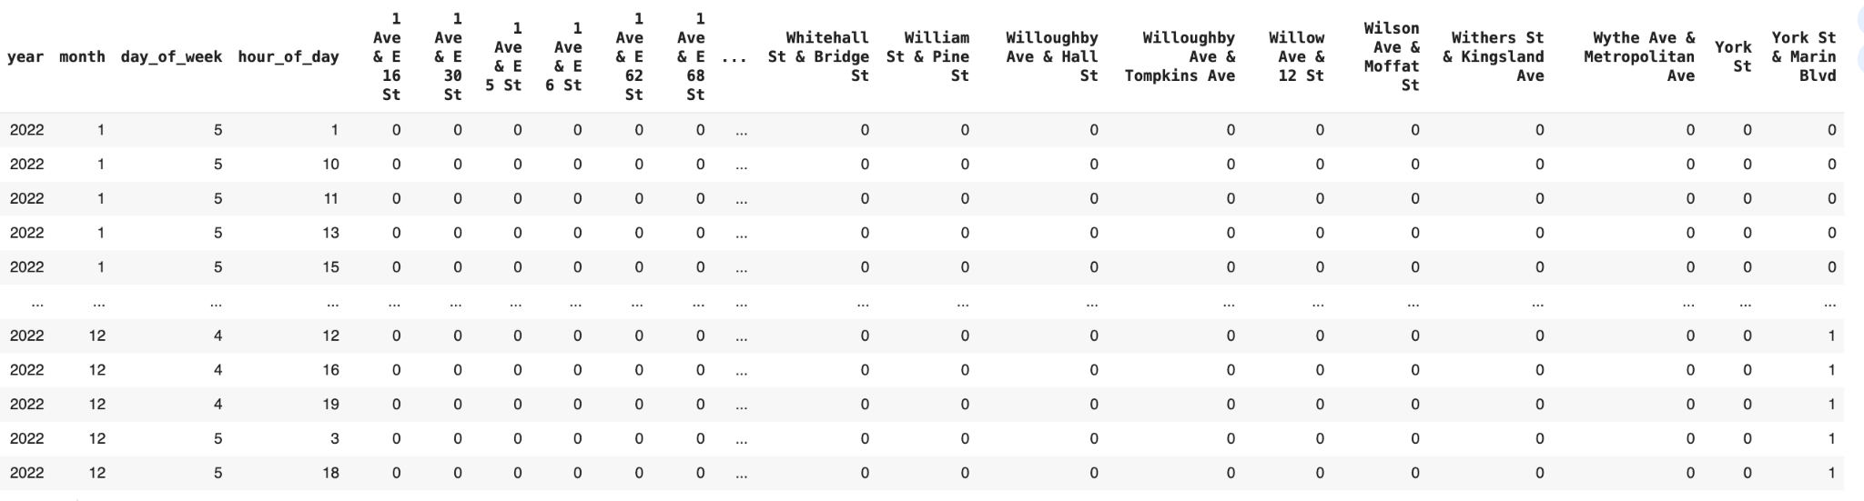
Feature Selection for Baseline Model
From our exploratory data analysis, we found that there are other factors that change the demand of bikes at stations such as:
Year
Month of the year
Day of the week
Hour of the day
Hot encoded the stations as features in our model.
Target label - incoming and outgoing rides for each station within every one-hour time frame.
Nikhil Arora, Gaurav Bhandari, Sarath Saroj
Notes:
As observed in the previous slides, there is a clear distinct monthly seasonality and yearly trend associated the bike demand. Also, we've noted that demand varies based on the hour and day of the week.
So these along with the hot encoded stations were incorporated as features for our baseline model.
The objective is to forecast the volume of incoming and outgoing rides for each station within every one-hour time frame.
We decided to train with 2021-2022 and test on 2023 data because training on the entire 5years data was taking too long and the kernel was crashing.

Slide 20
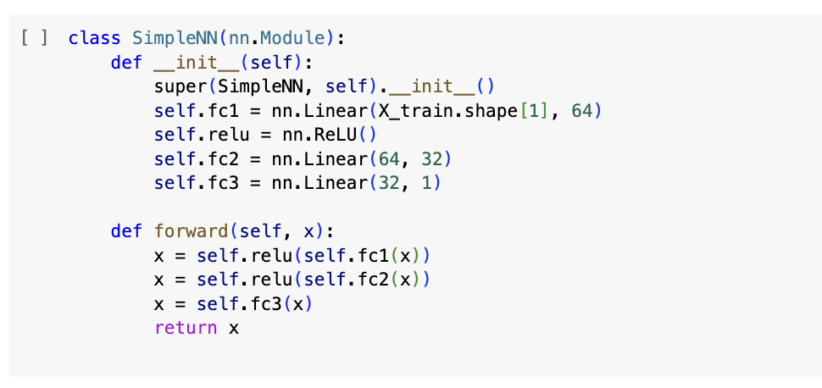
Model - Simple Feed Forward
2 hidden layers
ReLU Activation
Final Linear Layer
Nikhil Arora, Gaurav Bhandari, Sarath Saroj
Notes:
For the baseline model, we used a simple feed forward network of 2 hidden layers with ReLU activation function and a final Linear layer.
After multiple attempts, we decided to train with 2021-2022 and test on 2023 data because training on all 5years data was taking too long and the kernel was crashing.

Slide 21
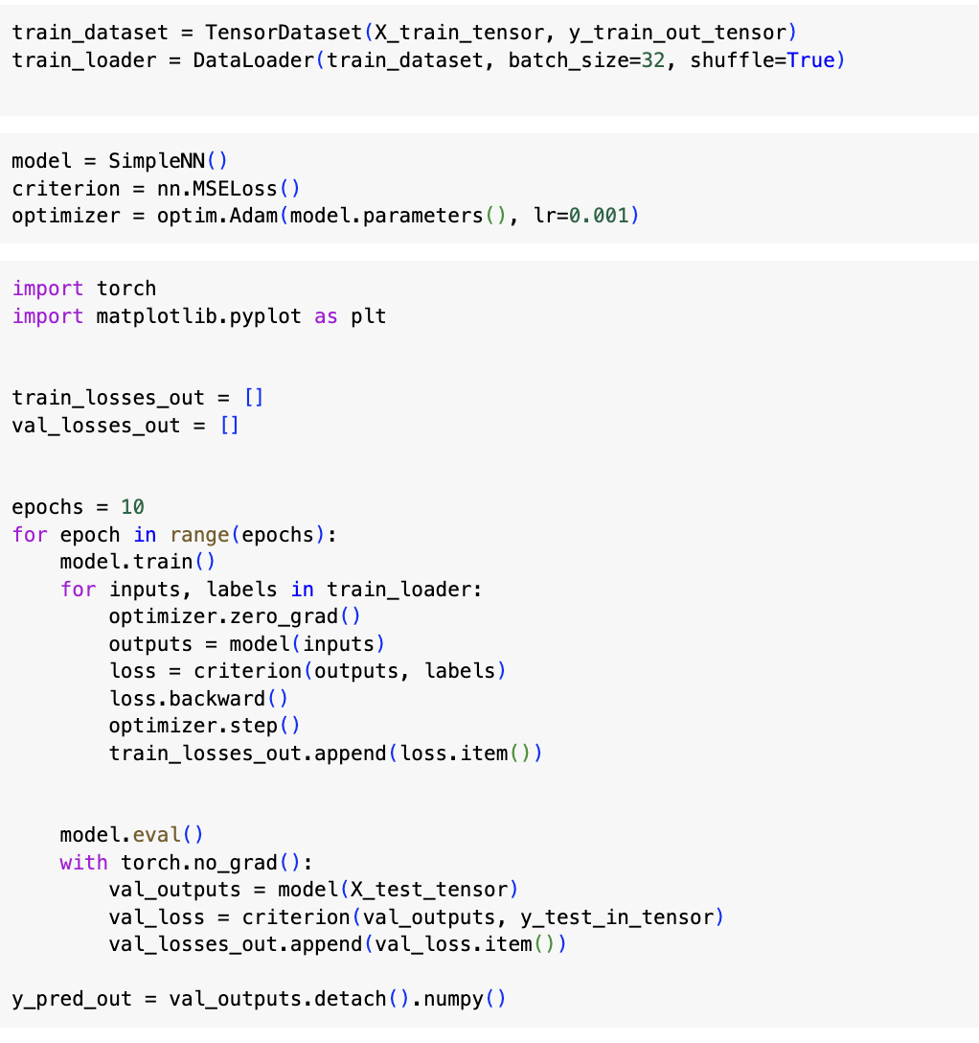
Hyperparameter
Batch size=32
Adam optimiser
10 Epochs
Nikhil Arora, Gaurav Bhandari, Sarath Saroj
Notes:
Batch size=32
Optimizer = Adam optimiser
No of epochs=10

Slide 22
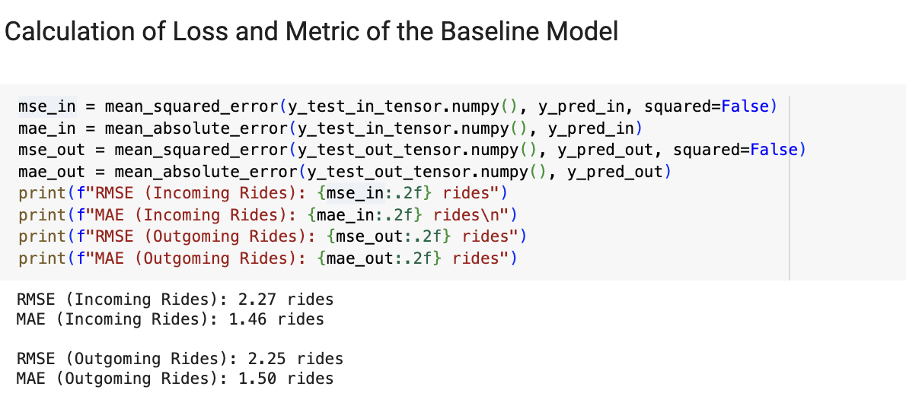
Evaluation of Baseline Model
Nikhil Arora, Gaurav Bhandar, Sarath Saroj
Notes:
The test loss and metric for the predicted incoming and outgoing rides is shown in the slide. The results can be definitely improved with a better model which uses Spatial - Temporal Neural network which will be discussed in the upcoming slides. MUTE THE MIKKKKKKKKKKKEEEEEEEEEEEEE!!!!!!!!!!!!!!!!!!!!

Slide 23
Final Model: STGCN

Slide 24
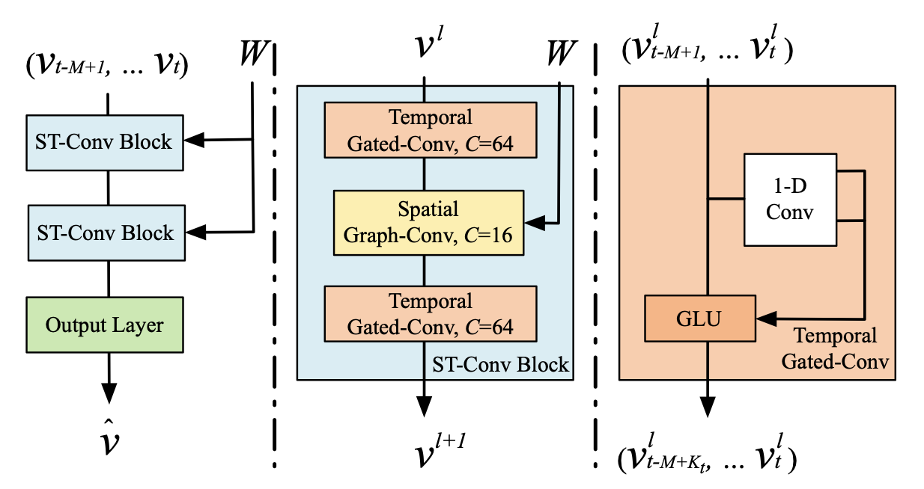
STGCN Model
Srushti Manjunath, Sarath Saroj
Notes:
We used a Spatio-Temporal Graph Convolutional Network to predict the traffic of Citi Bikes (departures and arrivals). In our architecture, we only used one spatio-temporal
convolution (ST-Conv) block because using 2 led to overfitting during our training. Subsequently there is an output layer with a final temporal convolution and a fully-connected layer.
The ST-Conv block consists of a spatial graph convolution between two temporal convolution layers. Temporal convolution layers work like time series prediction models, which
applies a function to each of the values in the window of these time steps. The output of this function is passed to a Gated Linear Unit (GLU), which selects features that are
relevant for subsequent predictions. Using our Citi Bike model as context, traffic information of these bikes at one station will influence the traffic information at nearby stations (essentially
”spreading” information across nodes).

Slide 25
Features
Number of unique stations: 498
Number of net rides for every 30 minute interval
Number of 30 minute intervals interval for 2023 data = 13104
V: Node features - Net rides for each node in the graph at each point in time
W: Distance for the edges between each pair of nodes(stations)
Srushti Manjunath, Sarath Saroj
Notes:
Our network consists of 498 unique stations. Each station acts as a node in our analysis
the data is divided into 30-minute intervals. This shows the net change in bike usage at each station, which is crucial for understanding patterns in demand and supply of bikes
Across 2023, we have 13,104 such intervals
Node Features (V): "For each station, or node, we have data on net rides for every time interval, allowing us to analyze usage patterns at each station over time."
Edge Weights (W): "The distances between stations are used as edge weights, helping us understand how the physical layout of the network influences bike-sharing patterns."

Slide 26
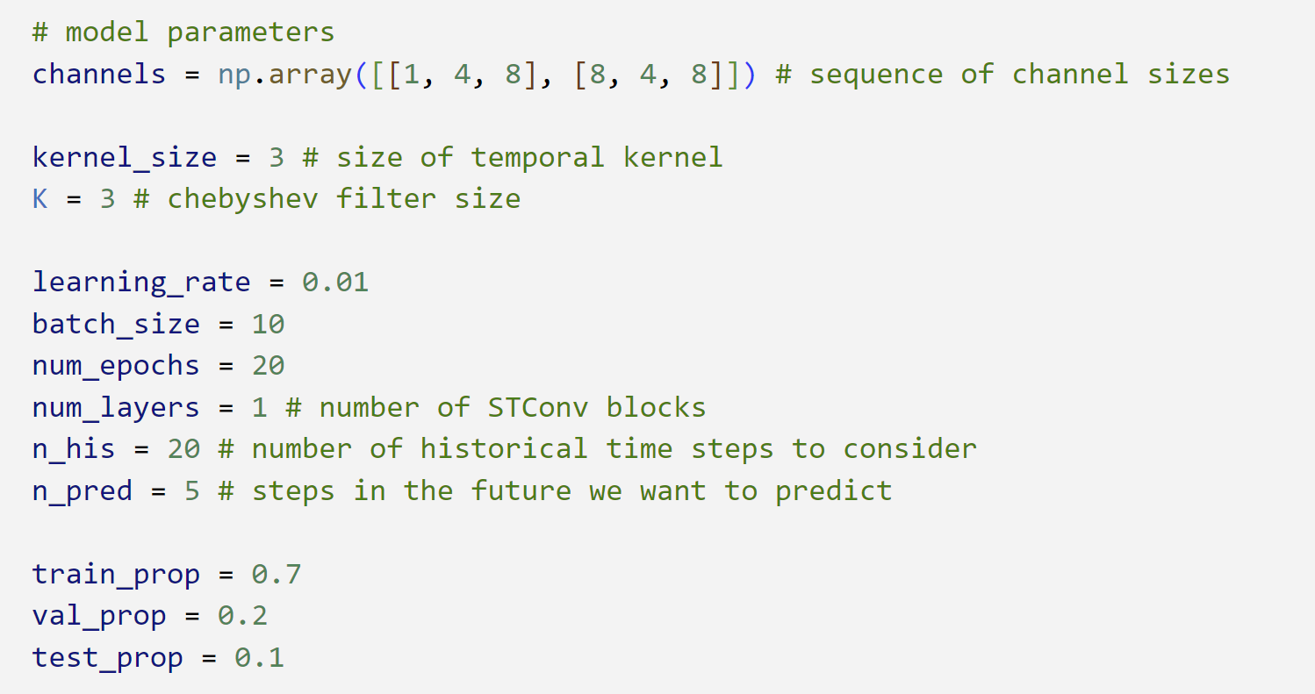
Model Parameters
Srushti Manjunath, Sarath Saroj
Notes:
Training this model is computationally intensive. We tried to run the model for 2-3 years of data but couldn’t complete it due to lack of gpu resources. So, we have trained the model only for 2023 data using these parameters which took around 26 hours to complete.

Slide 27
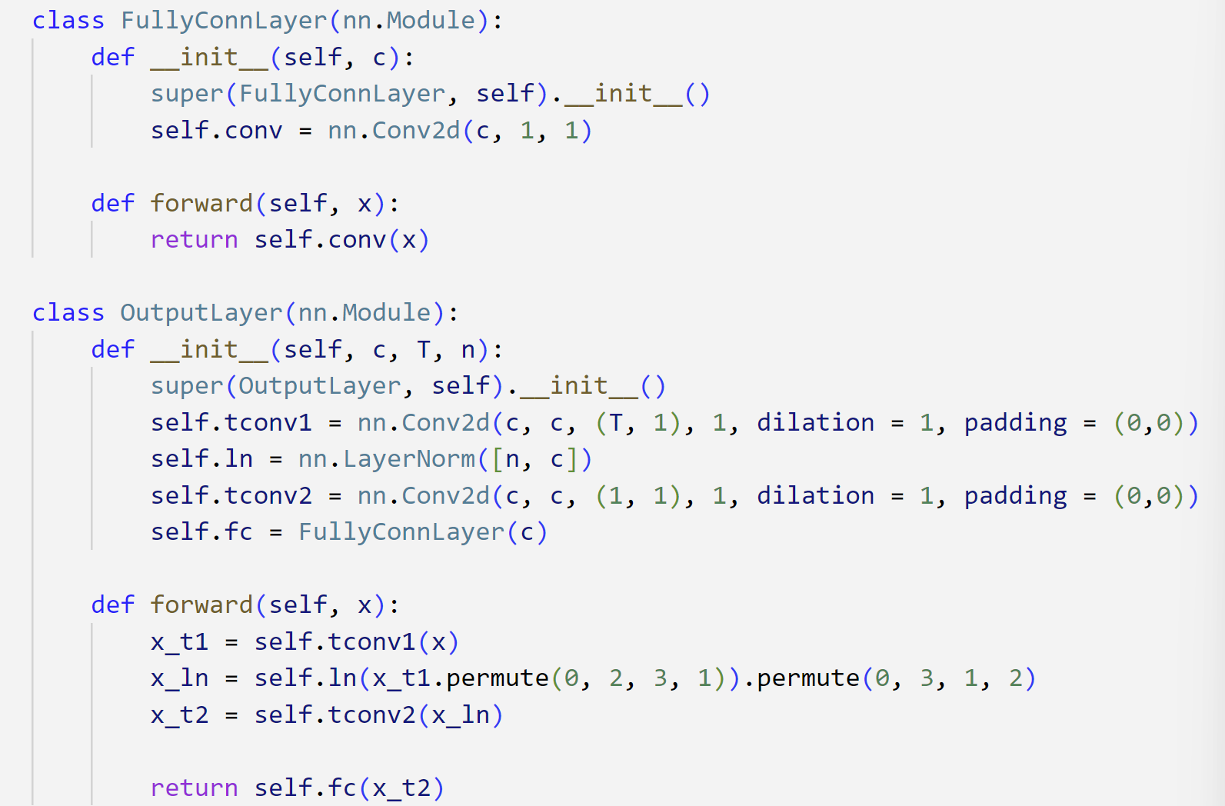
STGCN Model
Srushti Manjunath, Sarath Saroj
Notes:
This is the code for the STGCN model as explained earlier.

Slide 28
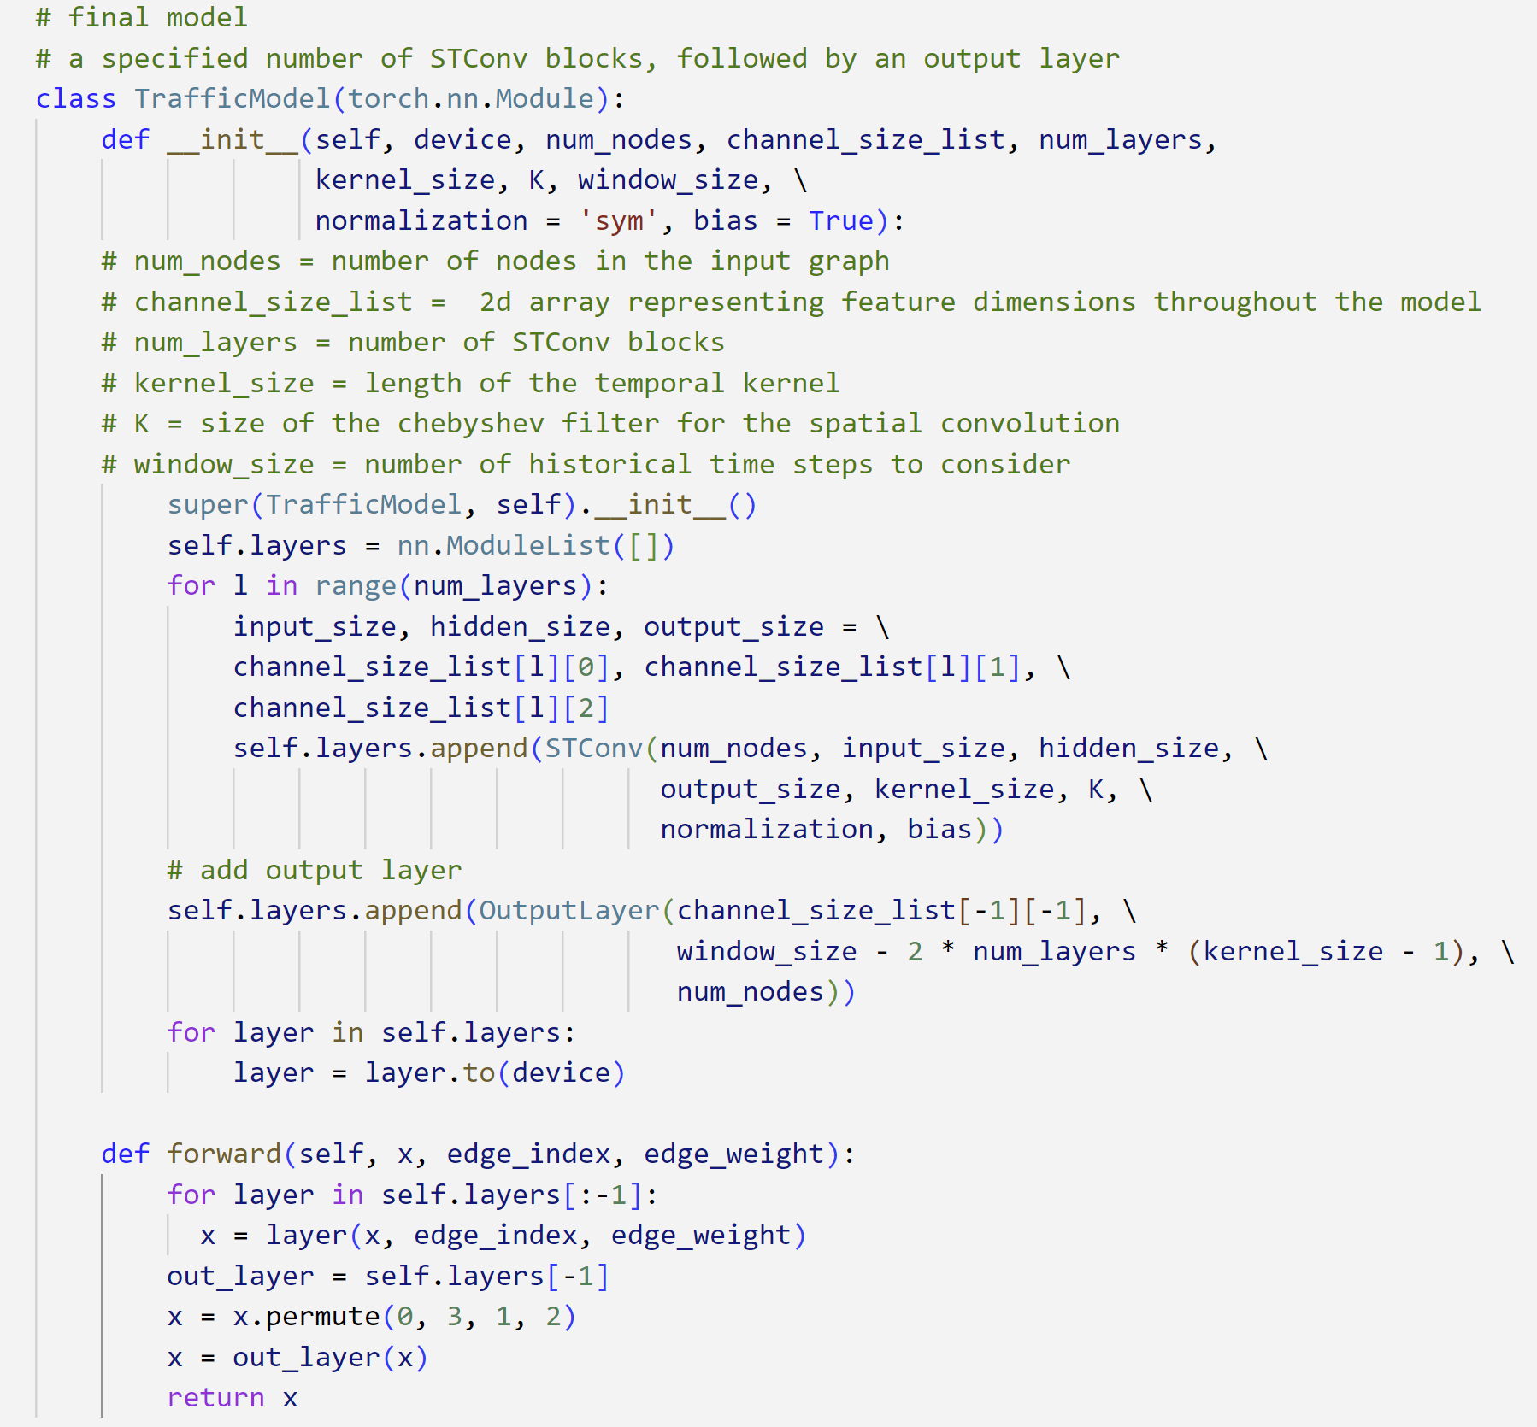
STGCN Model
Srushti Manjunath, Sarath Saroj

Slide 29
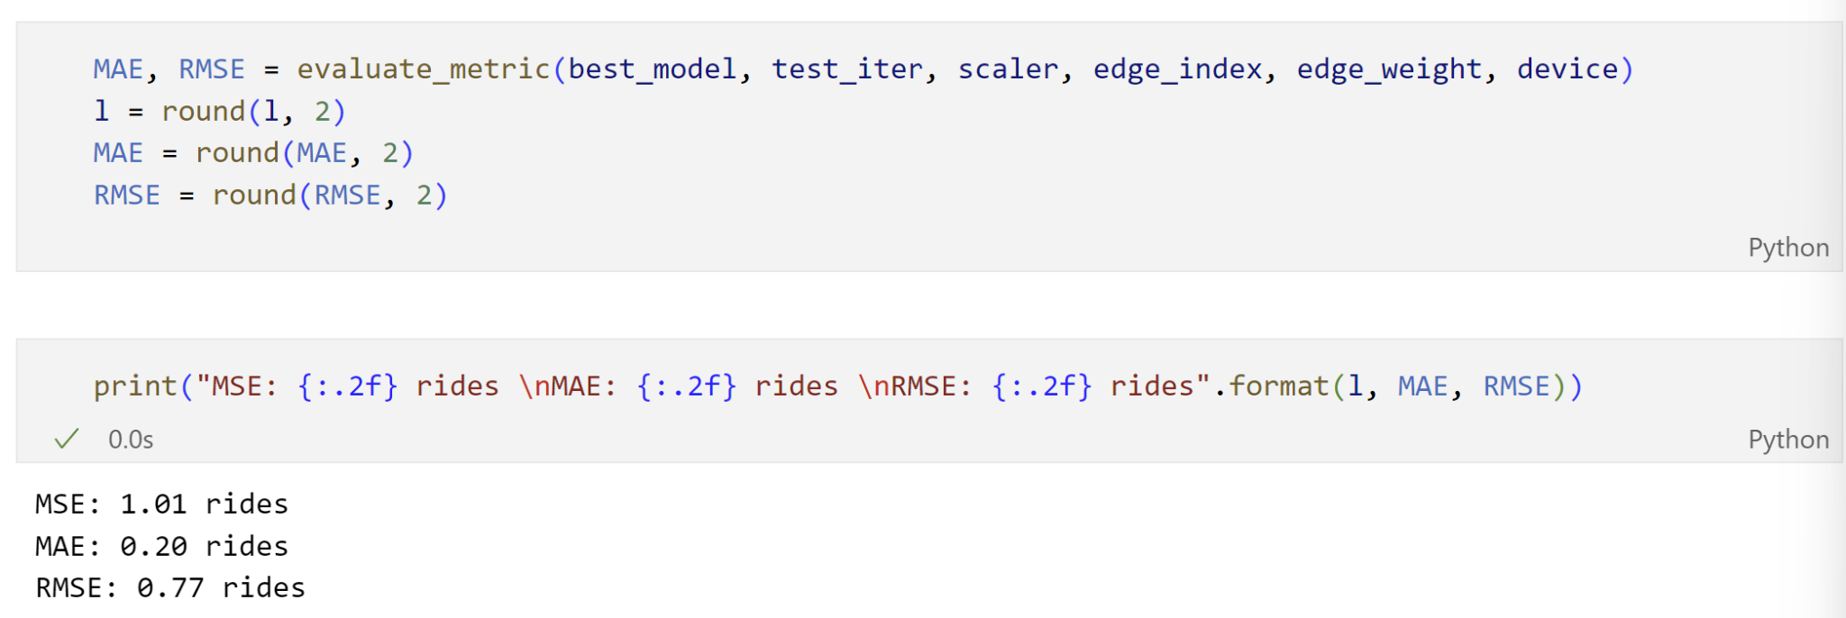
STGCN Model - Testing
Srushti Manjunath, Sarath Saroj
Notes:
The test loss after evaluating model with lowest validation loss on the test set is as shown.

Slide 30
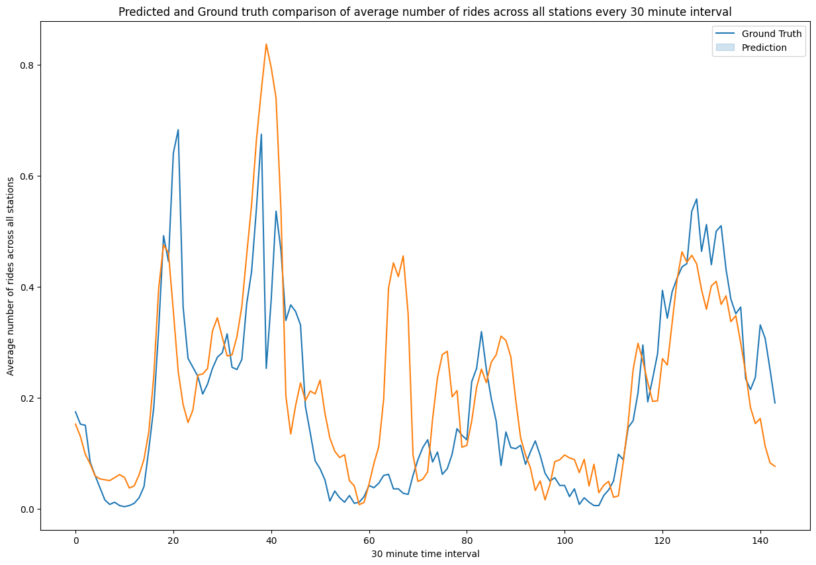
STGCN Model - Prediction
Srushti Manjunath, Sarath Saroj
Notes:
We predicted the net rides for 3 days and compared the ground truth with the prediction.
We have pretty close results

Slide 31
Results/Conclusions

Slide 32
Conclusions
On analyzing the station ride data we find that there is maximum activity in stations such as Grove St PATH station, Hamilton Park and Newport PATH.
On analysis we were able to identify that the rides data is very sparse in the Jersey City impling that most of the rides are on limited ride paths through the city. The demand is generated by only by few stations.
The stations which are high in demand such as Grove St Path and Hamilton Park have have high degree of imbalance in terms of net rides.
So a possible strategy to rebalance these is by sending vans to shift bikes from other smaller stations(in the vicinity) to these imbalanced stations at the end of business hours/maintenance hours
Nikhil Arora, Gaurav Bhandari, Srushti Manjunath, Sarath Saroj
Notes:
The Hamilton Park is a city

Slide 33
Technical Challenges

Slide 34
Some Considerations
Training the model for all the stations took a lot of computation time. In hindsight, we can run the model only for important stations to reduce the compute time.
Given more time for tuning better hyperparameters, along with better compute to operate on the samples, results could likely be improved further.
Sparse/imbalanced data problems, for stations ids.
Some rides did not have start/end stations.
Inconsistency of data, where in the same dataset had different formats within columns.
Weather data was merged and was used for EDA, however not used in prediction model.
Due to high running time- we experimented clustering- but found that the data was too sparse for small clusters within the Jersey City region and it only worked for New York City data as there were enough number of rides within the smaller clusters.
Nikhil Arora, Gaurav Bhandari, Srushti Manjunath, Sarath Saroj

Slide 35
Learning Experience

Slide 36
Accomplishments
We able to identify a problem that can be replicated, across network
As a team worked from start to finish we deployed code over the entire lifecycle of the project.
Gained experience in graphical neural networks (none of the members in the team, before this project had worked on GNN’s).
Understood the nuances of the deep learning concepts in application through this course.
Honed our data handling skills to effectively manage complex data.
Identified the importance of the teamwork, setting realistic timelines and dividing tasks based on inherent skill sets.
Nikhil Arora, Gaurav Bhandari, Srushti Manjunath, Sarath Saroj

Slide 37
Future Considerations

Slide 38
Looking Forward
We have shared the code to our Git repository and will continue to work on the project further.
We intend to work on the model for the whole duration of dataset available.(before 2023)
Work on improving the prediction window for beyond the present window.
Work on identifying new station locations, expand the network beyond. Work on the NYC dataset where there are many more rides between stations.
On an extended timeline work on a live data visualization and prediction model which is available publicly.
Nikhil Arora, Gaurav Bhandari, Srushti Manjunath, Sarath Saroj
Notes:
Explain reducing training times and new directions and states to include starting with NYC\

Slide 39
Git Repo
https://github.com/hiiamnikhil/IE434_Project_Deep_Dive7.git
Public Repo with all the team members as collaborators.
Link to google drive set up during the the project
https://drive.google.com/drive/folders/1Gj7FmEX9YPC2nalrhpvOYOHUmKhIF4Ct?usp=drive_link
Nikhil Arora, Gaurav Bhandari, Srushti Manjunath, Sarath Saroj

